Slide 1
Statistical discrimination of steroid profiles in doping control with support vector machines
Suruchi J. Ahuja
Rahul Gopalsamy
Nikhil Singhal
Aishwarya Mandava

Slide 2
Introduction :
Steroid profiling is one of the most informative tool to screen the misuse of performance enhancing endogenous steroids and their ratios (e.g.- testosterone(T) )in sports
Nowadays, slow releasing doses of endogenous steroids, particularly T preparations, are very popular among athletes as they are difficult to detect with current methods and criteria. As T might be used to power sports for muscle promotion, current proliferation might be explained by its prosperous effects on recovery after endurance exercises.
The T/E ratio is considered as one of the most sensitive markers to detect T use among athletes.
In the 90’s a wide range of these endogenous steroids became popular among athletes, and to avoid this a comprehensive steroid profiling method was developed which gave rise to the discovery of additional biomarkers (DHEA and Adion) with the potential to increase detection sensitivity for illicit use of several endogenous steroids.

Slide 3
In 2008,the introduction of the athlete biological passport(ABP) paved the path for systematic storage of test results coming from the same athlete. These longitudinal datasets allowed the calculation of individual reference ranges resulting in a more sensitive criterion as large inter-individual variances in concentrations of urinary steroid markers could be circumvented.
In the ABP, the assessment of reference ranges is performed by an adaptive Bayesian algorithm that accounts for all prior knowledge on population statistics a well as previous test results of athletes. Hence, for any number of prior test results, the ABP can calculate a reference limit at a given specificity.
As the number of test records increases, the calculated reference limits adapt from population statistics towards individual thresholds. In the last decade, a growing use of computer aided approaches has been used in fundamental research as well as in forensic science and doping analysis. These require data mining algorithms for evaluation of generated datasets. Such strategies have already proven to be very helpful in biomarker discovery, drug development or statistical classification of control and treated subjects .

Slide 4
A powerful machine learning technique called support vector machine (SVM), algorithm was developed to statistically evaluate urinary steroid pro- files composed of an extended range of steroid profile metabolites. This model makes the interpretation of the analytical data in the quest for deviating steroid profiles feasible and shows its versatility towards different kinds of misused endogenous steroids. The SVM model outperforms the current biomarkers with respect to detection sensitivity and accuracy, particularly when it is coupled to individual data as stored in the Athlete Biological Passport.
Here, a feasible approach using an SVM algorithm solution was proposed as discriminative approach for the global evaluation of the steroid profile and to improve the detection efficiency of screening methods for misuse with endogenous steroids.

Slide 5
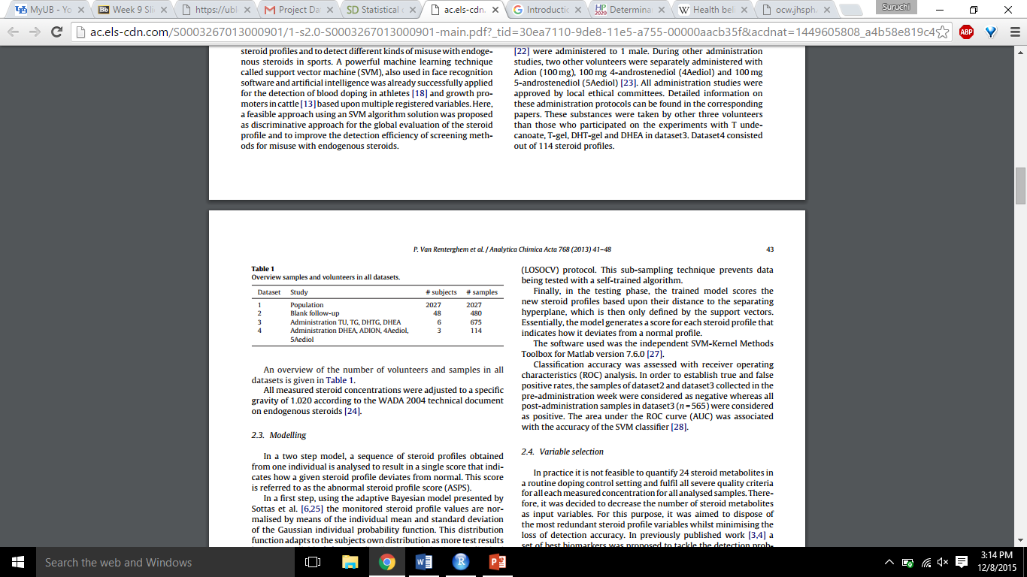
Data Collection - In total 4 datasets are collected,
Dataset 1- A population study with 2027 negative urines of healthy male athletes was performed.
Dataset 2- A population study with 48 health male volunteers was performed. The volunteers provided 10 blank urine specimens during a 5 month period. This dataset consisted of 480 samples in total.
Dataset 3- Six healthy male volunteers were administered with small recommended doses of T undecanoate, T-gel, DHT-gel, and DHEA.
Dataset 4- Previously produced excretion urine samples were analyzed with the same analytical methods: in different administration trials.

Slide 6
Objective
Our main objective is to determine abnormal steroid profile score(ASPS)
This is done with two step model.

Slide 7
Modelling
Step 1: Adaptive Bayesian model
The monitored steroid profile values are normalised.
The datasets 1,2 and 3 are used for the calculation of prior distributions of inter and intra individual steroid profile variables.As test observations increase, the distribution adapts to the subject’s own distribution.
Step2: SVM using gaussian radial basis function kernel
Used for lateral evaluation of the individualised steroid profiles.

Slide 8
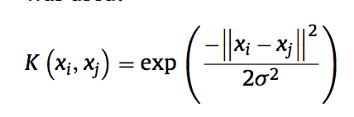
SVM
Steroid profile is projected on to higher dimensions to find a hyperplane that separates them into two classes.
1) Positive -1 (Post-administration)
2) Negative labelled +1 (blank steroid profile)
Due to non-linear nature of this problem Gaussian radial basis function is used.
x_{i} and x_{j} are two points in n dimensional space.
width of Gaussian to map data in a higher dimensional feature space (Kernel parameter)
In order to avoid over fitting of data a penalty constant C is used.

Slide 9
SVM cont.
The SVM model is trained on samples used in Dataset 2 and 3.
In testing phase the trained model scores the new steroid profiles based upon the distance to the searing hyperplane.

Slide 10
Variable selection
It is not feasible to quantify 24 steroid metabolites in a routine doping control setting.
The best variables are selected by removing the redundant ones.
This was done iteratively by SVM to get the best detection sensitivity.
Finally the model with 11 steroid metabolites were chosen.T, E, 5 Adiol, 5 Adiol, DHT, 5cyclo, 7 -OH-DHEA, 6 -OH-Adion, 4-OH-Adion, 16 -OH-DHEA and 16 -OH-Adion.

Slide 11
Results

Slide 12
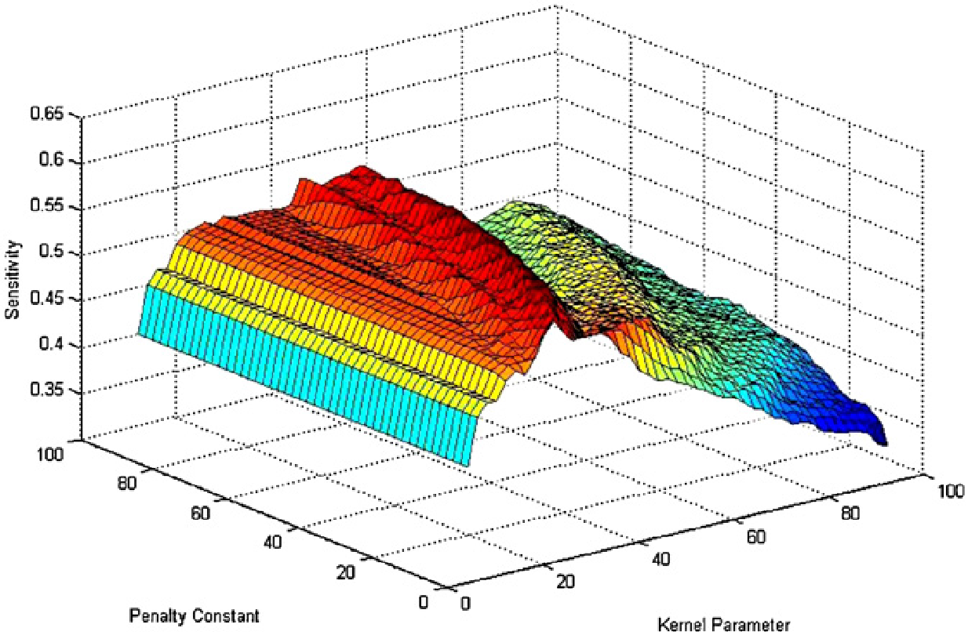
Optimization
Detection Sensitivity = f(PC, KP)
PC is Penalty Constant
KP is Kernel Parameter
PC and KP selected using grid search & step size 2
Zeroed in on KP = 45 & PC = 48

Slide 13
Optimization & Settings
Data analyzed in Leave One Subject Out Cross Validation manner on Data-Set 1
Similar to evaluating new athletes using info in ABP
Out of original 480 steroid profiles, 24 were used
On average 132 +- 11 SV were created

Slide 14
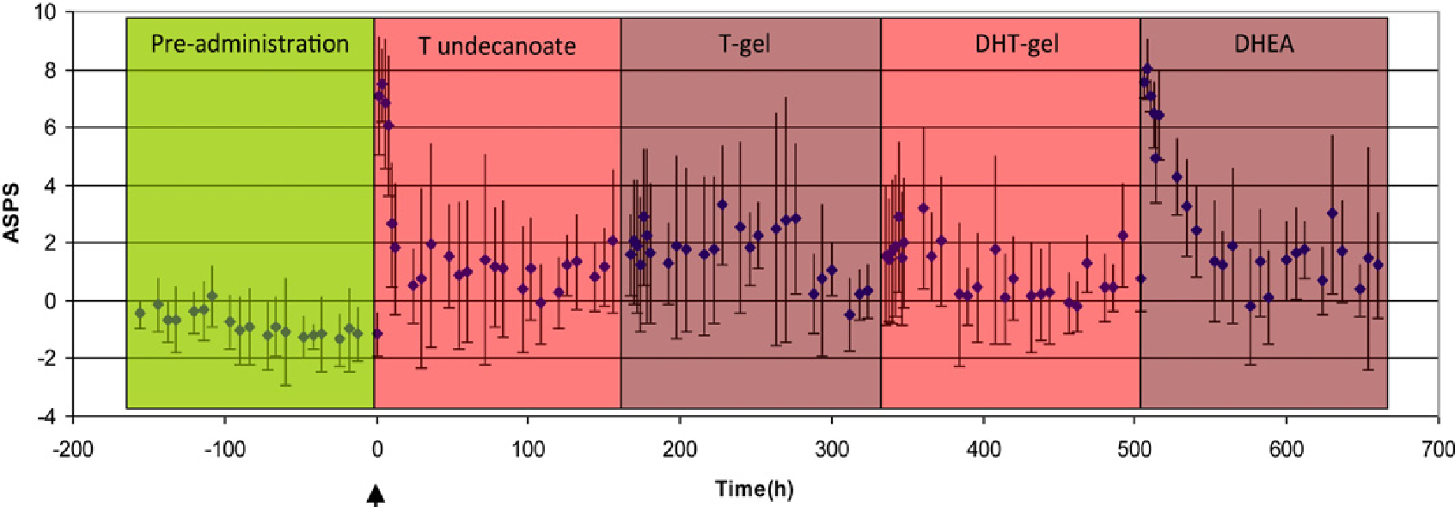
Data-Set 3 ASPS
Low ASPS values before administration, higher afterwards
Higher by ~ 9 (p < 0.005, unpaired T-test)
But, no clear separation b\wn positive & negative samples at end of washout
Aim to design model for max discrimination b\wn pre & post dosage along with max detection times for mis-use

Slide 15
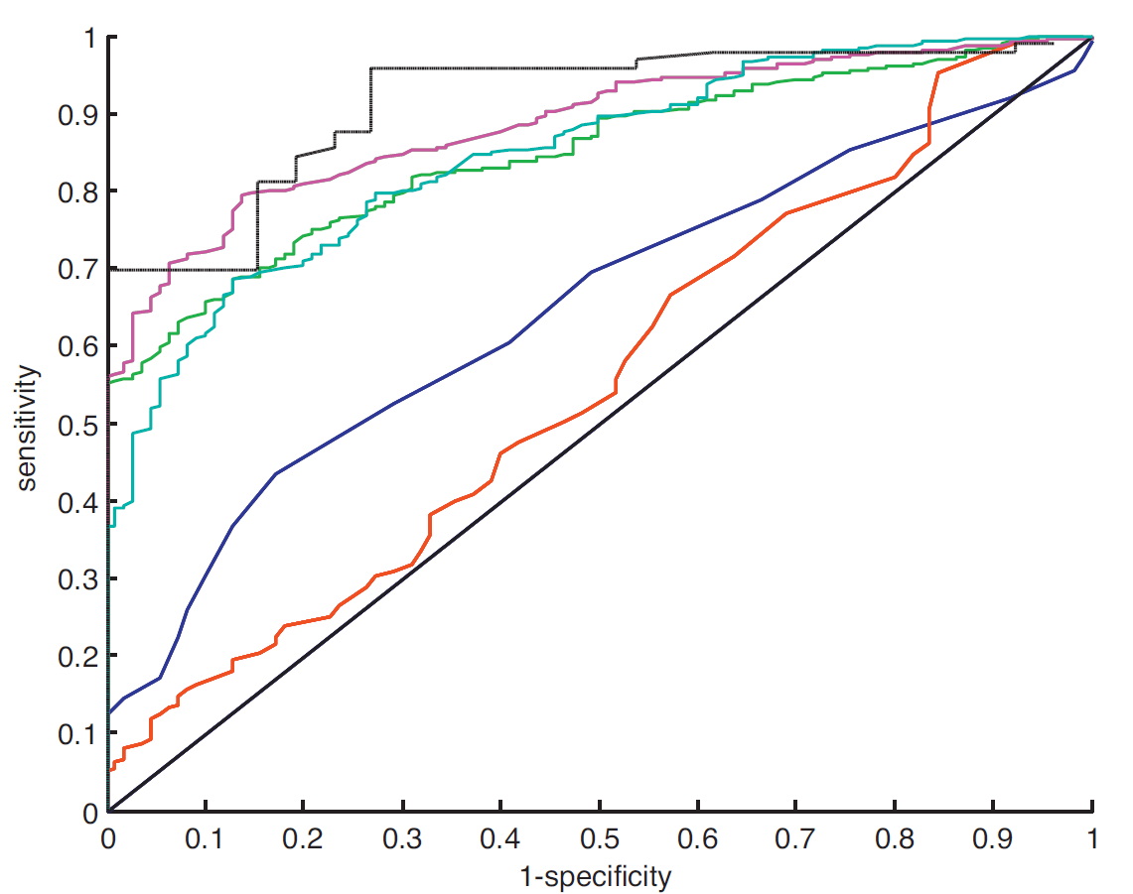
Overall Model Performance
Accuracy of model after 1 week (sensitivity) vs False Positive
T/E Ratio Population
Area under curve – 0.552
T/E Ratio Individual
Area under curve – 0.648

Slide 16

Performance Evaluation cont’d
SVM Model on DS 3 & 24 ratios
Area under curve – 0.838
SVM model on DS 3 & 11 ratios
Area under curve – 0.886
Validated robust SVM Model on DS 2 & 3 with 11 ratios
Loss in sensitivity but gained generalization
Validated robust SVM Model on DS 4 with 11 ratios
Area under curve – 0.877

Slide 17
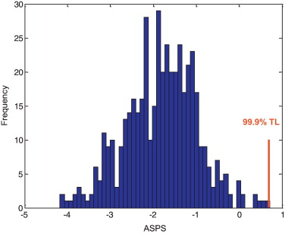
ASPS threshold and detection times
Establishes a discrimination threshold of 0.79
Histogram of 590 ASPS values from blank steroid profiles in dataset2(480) and dataset3(110)

Slide 18
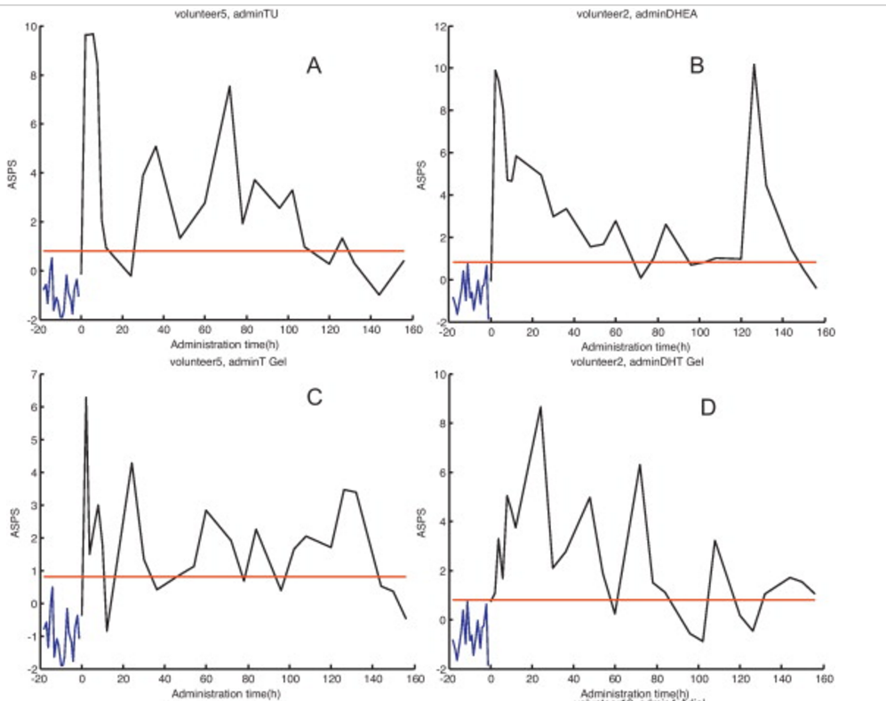
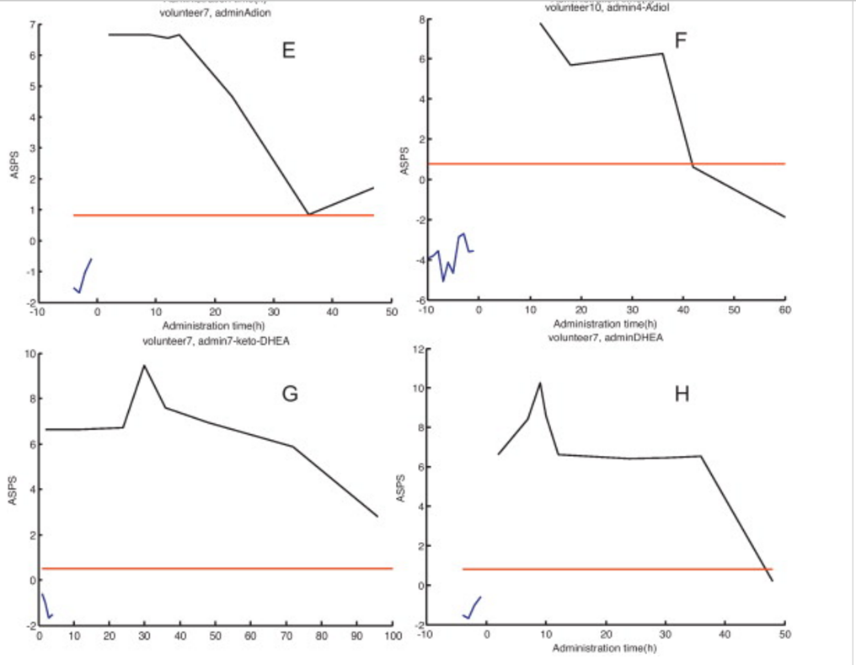
Individual ASPS profiles
A-D : Dataset 3(administered with TU,DHEA,T gel, DHT gel,)
E-H: Dataset 4(administered with DHEA,ADION,4Aediol,5Aediol)

Slide 19
Detection times
None of the steroid profiles from samples collected before administration exceeds the threshold of 0.79
ASPS of post-administration profiles increase up to 10 units
 | Classical detection | SVM model
TG | 30 hours | 7 days
DHEA | 60 hours | 7 days
Adion | 9 hours | 48 hours
7-keto-DHEA | 9 hours | 96 hours

Slide 20
Discussion
New strategy that returns a single value for ASPS
A combination of SVM algorithm and longitudinal approach for steroid profiling enables to differentiate normal and abnormal steroid profiles
The presented SVM model quantifies the deviation from testing steroid profile by scoring its distance to separating hyperplane. For the score greater than threshold 0.79 is considered abnormal
Validation of SVM was done using LOSOCV
Risk of overfitting(dataset2&3) is addressed by LOSOCV. Expansion of the validation set(dataset3) with additional 48 volunteers enhanced the stability and robustness of the algorithm
Using SVM models alteration of steroid profile due to doping can be detected sensitively with long detection(upto 7 days)
Excellent results were obtained for challenging steroid profiles
Results for test set(dataset4) were very good with sensitivity 70% and risk of overfitting was minimised
In relation to the former biomarkers(such as T/E ratio) the presented SVM models demonstrated very high diagnostic performance

Slide 21
REFERENCES
•Statistical discrimination of steroid profiles in doping control with support vector machines
Pieter Van Renterghem, Pierre-Edouard Sottas,
Martial Saugy, Peter Van Eenoo
•P. Van Renterghem, P. Van Eenoo, F.T. Delbeke, H. Geyer, W. Schänzer
Steroids, 75 (2010), p. 154
•P. Van Renterghem, P. Van Eenoo, F.T. Delbeke
Steroids, 75 (2010), p. 1047
•P.-E. Sottas, N. Baume, C. Saudan, C. Schweizer, M. Kamber, M. Saugy
Biostatistics, 8 (2007), p. 285

Slide 22
Critical Questions
Instead of the unpaired T-test which other test could have been used and why?
Suggest an alternative classification method for this data set(non- linear data)

